Slide 1
BASIC PATH TESTING

Slide 2
Introduction
◆ A white box method
◆ Developed by McCabe in 1976
◆ A hybrid of path testing and branch testing methods.
◆ Based on Cyclomatic complexity and uses control flow to establish the path coverage criteria referencing the book C.Berge, Graphs and Hypergraphs (G&HG).

Slide 3
Cyclomatic Complexity
◆ Measures the number of linearly independent paths through a program.
◆ The higher the number the more complex the code.
◆ The cyclomatic number v(G) of an (undirected) graph G (which may have several disconnected components) is defined as:
v(G) = e - v + p
where e = number of edges, v = number of vertices, p = number of connected components

Slide 4
Basic path testing approach
◆ Step 1: Draw a control flow graph.
◆ Step 2: Determine Cyclomatic complexity.
◆ Step 3: Find a basis set of paths.
◆ Step 4: Generate test cases for each path.

Slide 5
Converting Code to Graph
CODE
FLOWCHART
GRAPH
if expression1 then
statement2
else
statement3
end if
statement4
For a strongly connected graph:
Create a virtual edge
to connect the END node
to the BEGIN node
T
expr1
?
F
n1
statm2
statm3
n2
n3
statm4
n4
switch expr1
case 1:
statement2
case 2:
statm3
case 3:
statm4
end switch
statm5
1
expr1
?
3
n1
2
statm2
statm3
statm4
n2
n3
n4
In that case,
V= e – n + 1
statm5
n5
do
statement1
while expr2
end do
statement3
statm1
n1
expr2
?
T
n2
F
statm3
n3

Slide 6

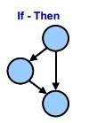
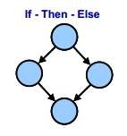

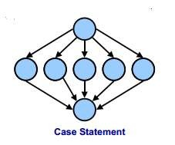
Draw a control flow graph
◆ Basic control flow graph structures:

Slide 7
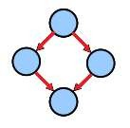
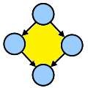
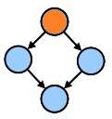
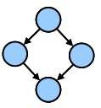
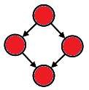
Draw a control flow graph
Arrows or edges represent flows of control.
Circles or nodes represent actions.
Areas bounded by edges and nodes are called regions.
A predicate node is a node containing a condition.

Slide 8
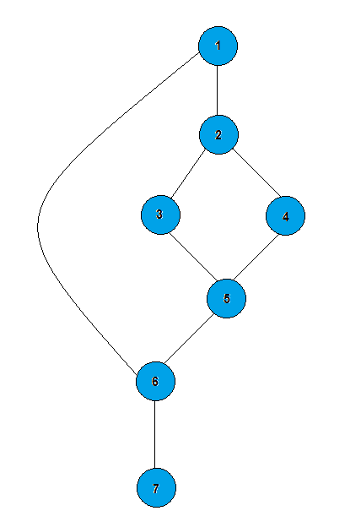
Draw a control flow graph
◆ 1: IF A = 100
◆ 2: THEN IF B > C
◆ 3: THEN A = B
◆ 4: ELSEA= C
◆ 5: ENDIF
◆ 6: ENDIF
◆ 7: Print A

Slide 9
Determine Cyclomatic complexity
There are several methods:
Cyclomatic complexity = edges - nodes + 2p
Cyclomatic complexity= Number of Predicate Nodes + 1
Cyclomatic complexity =number of regions in the control flow graph

Slide 10
Determine Cyclomatic complexity
Cyclomatic complexity = edges - nodes + 2p
◆ p = number of unconnected parts of the graph.
Cyclomatic complexity = 8-7+ 2*1= 3.

Slide 11
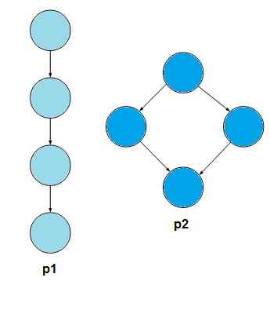
Determine Cyclomatic complexity
Cyclomatic complexity = edges - nodes
+ 2p
Cyclomatic complexity
= 7-8+ 2*2= 3.

Slide 12
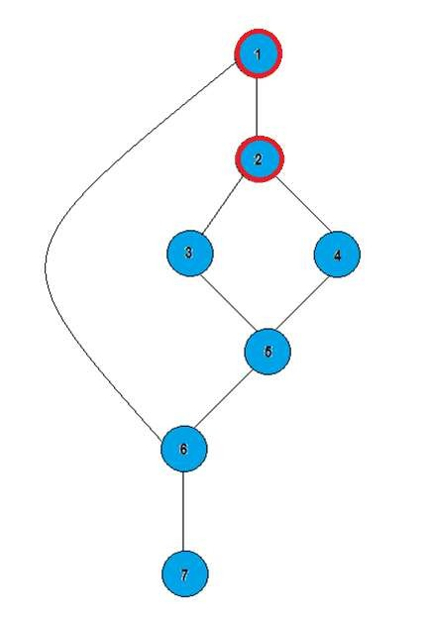
Determine Cyclomatic complexity
Cyclomatic complexity= Number of Predicate Nodes + 1
Cyclomatic complexity
= 2+1= 3.

Slide 13
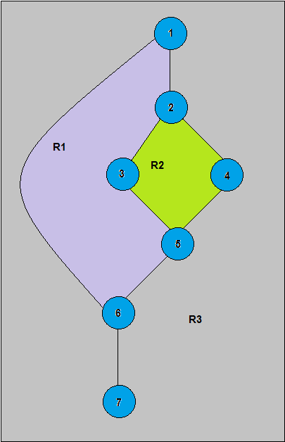
Determine Cyclomatic complexity
Cyclomatic complexity =number of regions in the control flow graph
Cyclomatic complexity
= 3

Slide 14
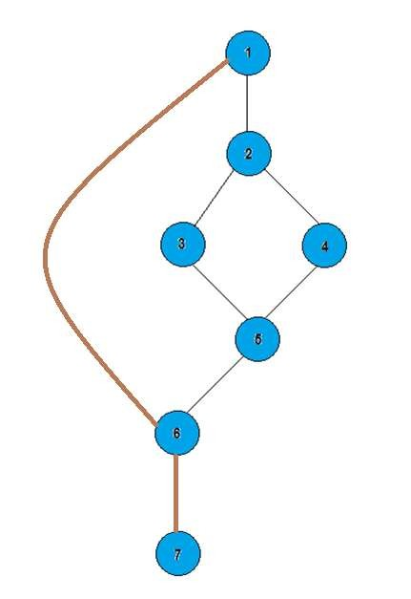
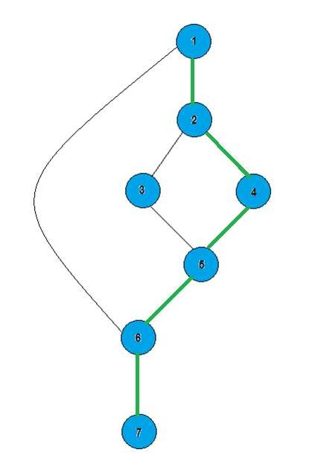
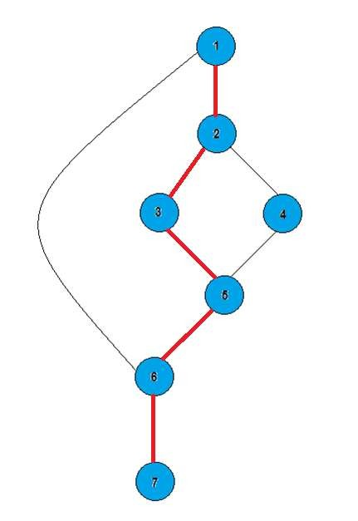
Find a basis set of paths
◆ Path 1: 1, 2, 3, 5, 6, 7.
◆ Path 2: 1, 2, 4, 5, 6, 7.
◆ Path 3: 1, 6, 7.

Slide 15
Generate test cases for each path
◆ We have 3 paths so we need at least one test case to cover each path.
◆ Write test case for these paths .

Slide 16
Conclusion
◆ Basic path testing helps us to reduce redundant tests.
◆ It suggests independent paths from which we write test cases needed to ensure that every statement and condition can be executed at least one time.

